Slide 1
Regions of North Carolina

Slide 2
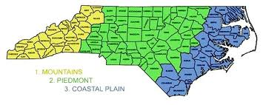
Regions of North Carolina
North Carolina is divided in three distinct regions.
Mountains
Piedmont
Coastal Plain

Slide 3
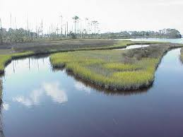
The Coastal Plain
The Outer Coastal Plain (Tidewater)
Flat
Many swamps and saltwater marshes
Elevation – Sea Level to 20-30 feet above sea level

Slide 4
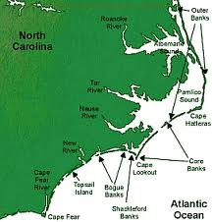
The Coastal Plain The Barrier Islands of the Outer Banks
Long narrow islands
between the ocean and
the coastline of the
mainland

Slide 5
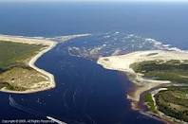
The Coastal Plain Inlets
Openings between the Barrier Islands
Shallow and always changing

Slide 6
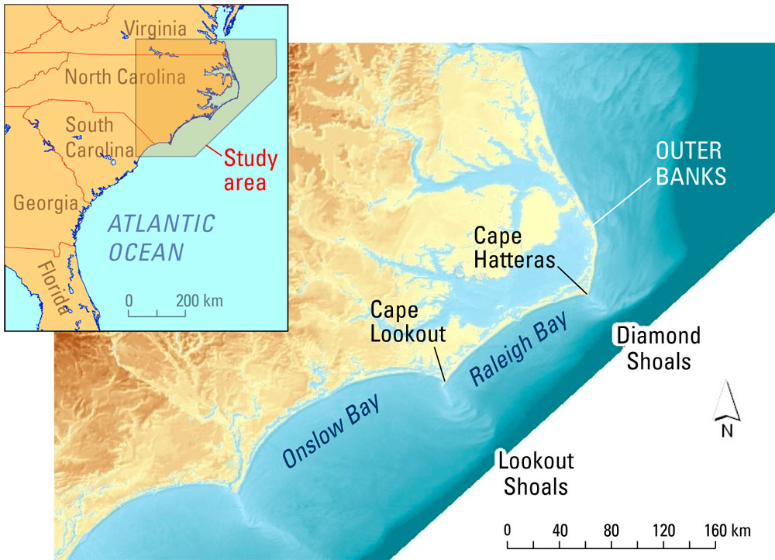
The Coastal Plain Capes
Points of land that stick out into the ocean

Slide 7
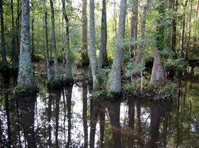
The Coastal Plain Wetlands
Saltmarshes and swamps
Low lying areas where the water is always near or above the surface of the land.

Slide 8
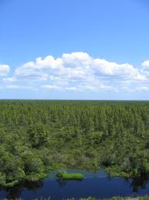
The Coastal Plain Pocosins
Large swamp areas on high ground covered by bushes and shrubs.
Pocosin is an Algonquin Indian word meaning “swamp on a hill”

Slide 9
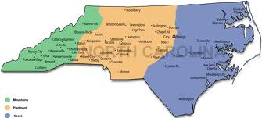
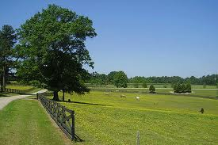
The Piedmont
“Foot of the Mountain”
Wide, rolling plateau
Hills and low mountains
300-1,500 feet above sea level

Slide 10
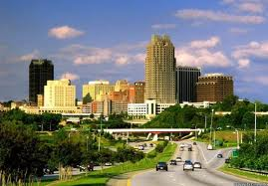
The Piedmont Cities
Most large cities are in the Piedmont.
Raleigh
Charlotte
Winston Salem

Slide 11
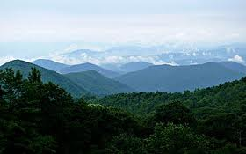
The Mountain Region
The North Carolina Mountains belong to the Blue Ridge Mountains and the Great Smoky Mountains which belong to the Appalachian Mountain range. This extends from Canada to North Carolina.

Slide 12
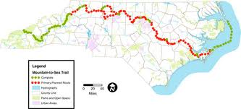
North Carolina
From the mountains to the sea, North Carolina offers great variety geographically.

Slide 13
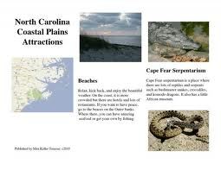
Task
We all know that the economy is not so great right now.
People are losing jobs or taking pay cuts. North Carolina’s
tourist industry has also taken a loss. People just aren’t
traveling as much because they just do not have the
money. Your job is to create a brochure or advertisement
that convinces people that North Carolina and its regions is
the place to travel.

Slide 14
Task
The brochure or advertisement will contain the following for each region:
At least one picture but not more than three.
Identify 2-3 features and of the region (physical, political, cultural, urban and rural) and how they characterize the region.
Compare and contrast how the regions are similar and different.
List 2-3 things to do in the region.
Convince people that NC is a great place to visit.

