Slide 1
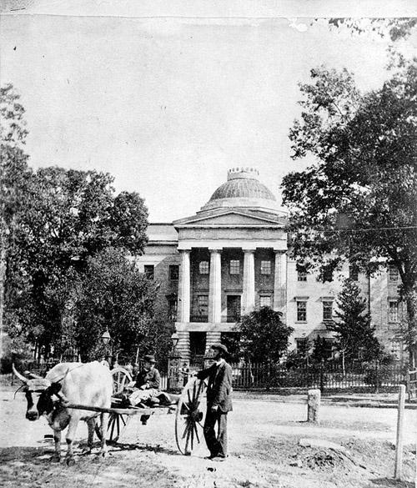
How did moving the capital to Raleigh change Wake County?

Slide 2
Standards *3.H1.1 Explain key historical events that occurred in the local community and regions over time. *3H1.2 Analyze the impact of contribution made by diverse historical figures in local communities and regions over time

Slide 3
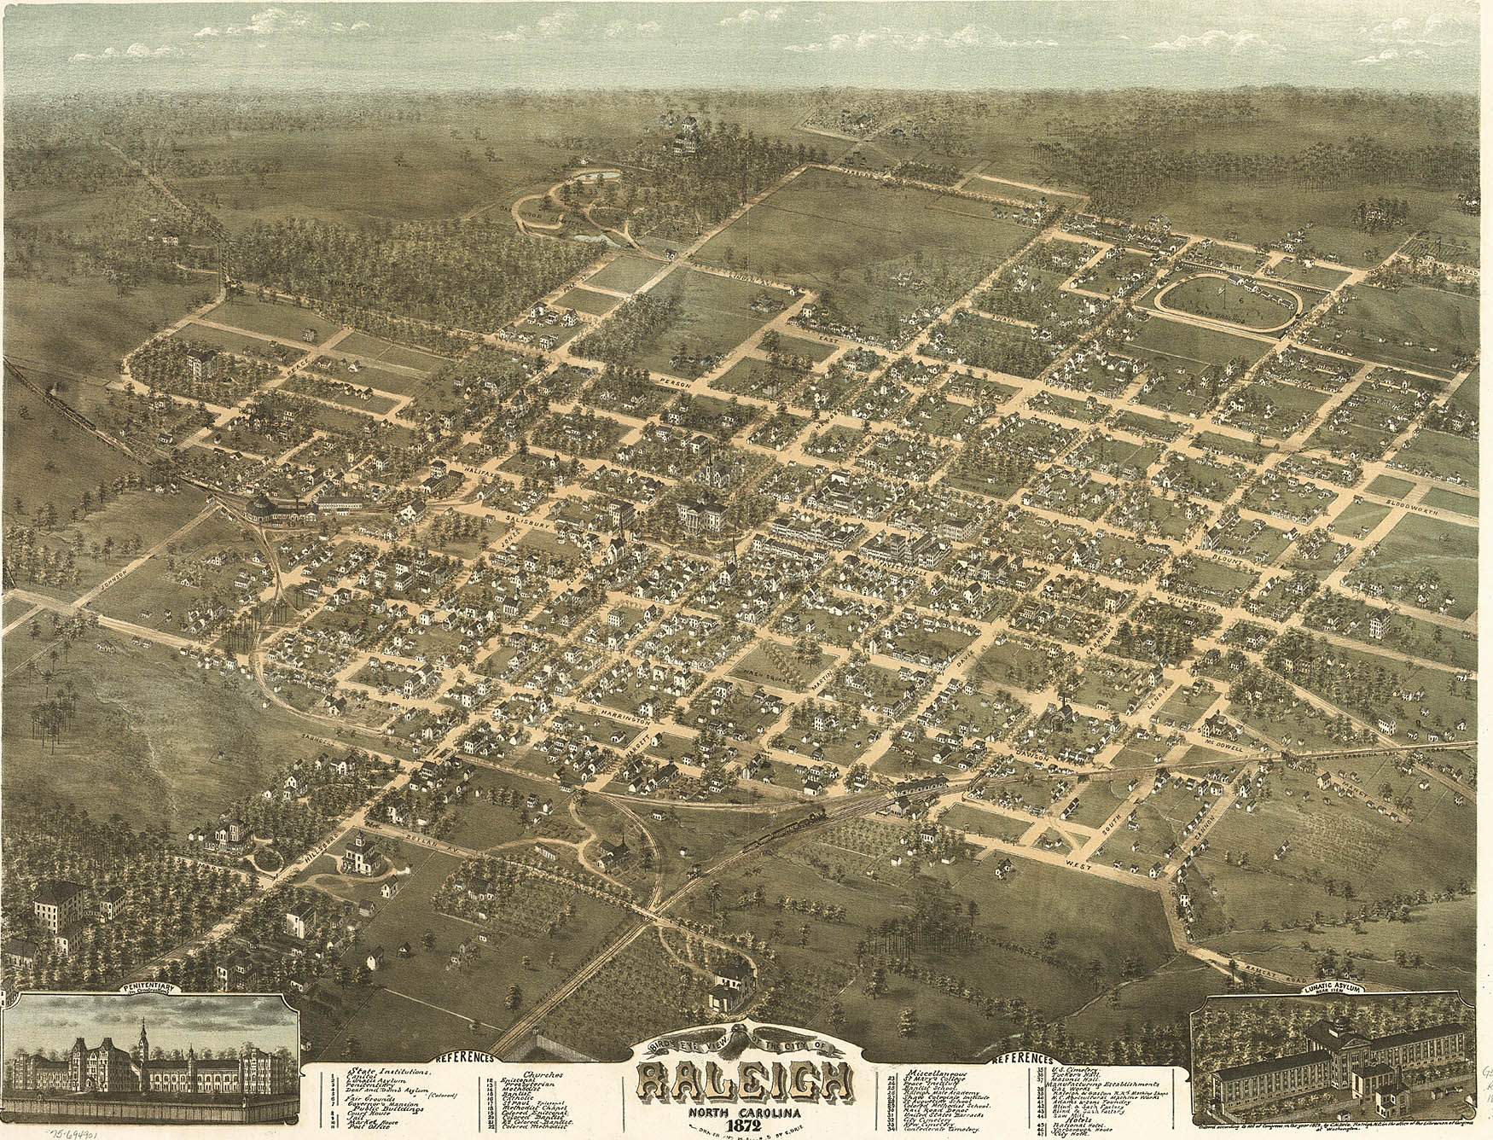
Raleigh in 1872

Slide 4
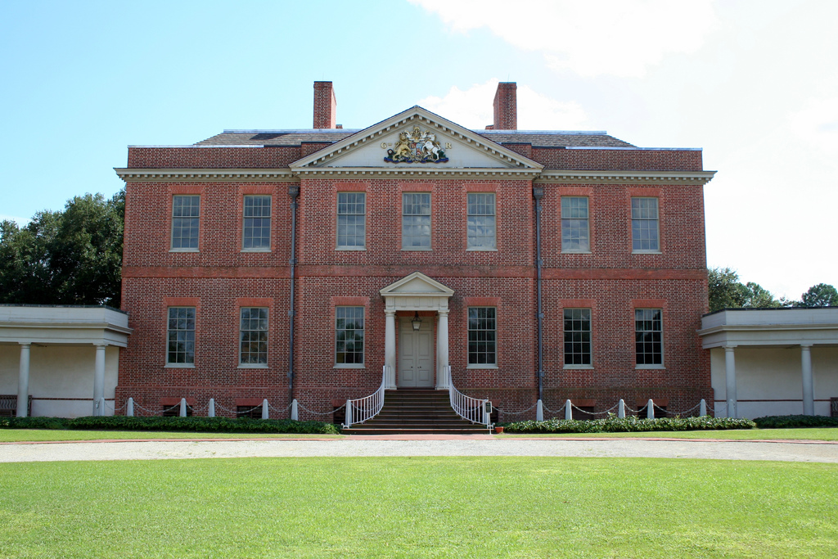
Tryon Place

Slide 5
1776
New Bern served as the colony’s seat of government and Tryon Palace was constructed to serve as the Governor’s residence. However during the Revolution the palace was though to be part of the royal government so legislature voted to move it.

Slide 6
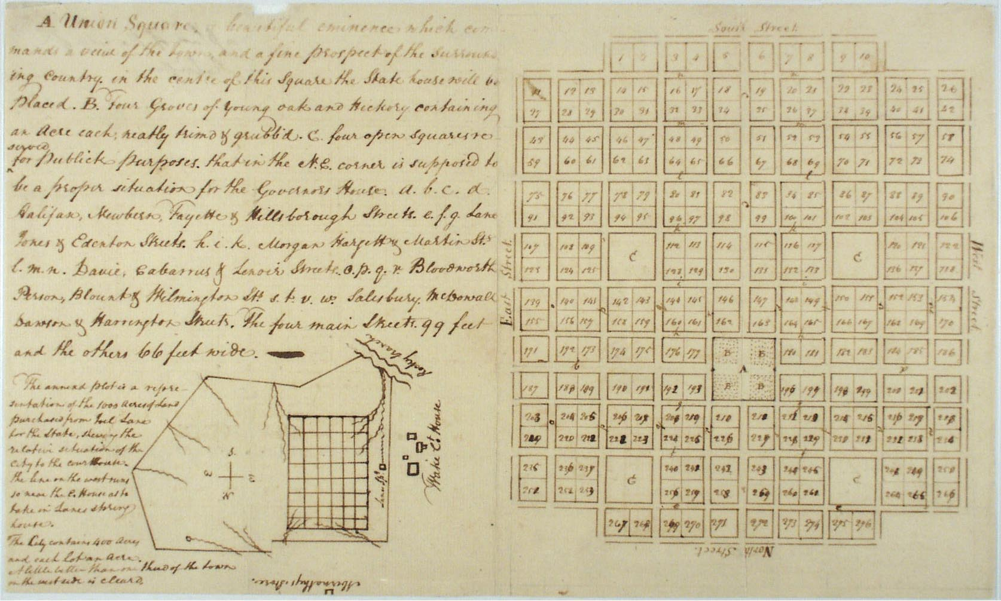
A Capital in the “Wilderness” – there was nothing here then

Slide 7
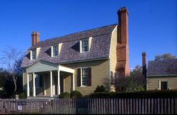
Joel Lane- He is considered the “Father of Raleigh”. He was a planter and state senator from whom that the land for the capital was bought. He had twelve children. His house was built in 1769 and hosted many travelers.

Slide 8
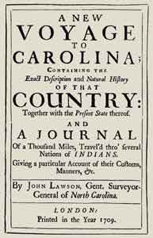
John Lawson- help found Bath and New Bern. He was famous for being the first to move west of the coast.

Slide 9
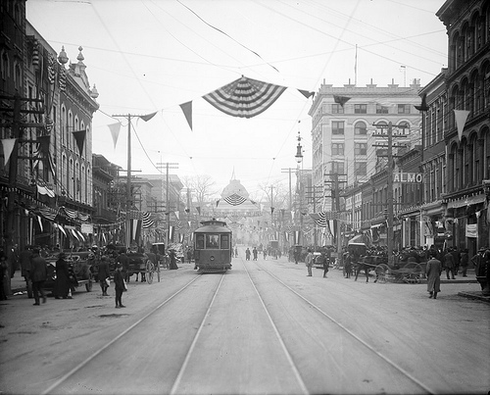
Fayetteville Street in Raleigh 1910 to 2014

Slide 10
What did you learn?

Slide 11
Summary
The Capital gave reasons to move or travel to Raleigh
Businesses opened to provide for needs of people

